Slide 1
Representing Servius: An Object-Oriented Approach
Katy Felkner
Advisor: Dr. Samuel Huskey, Classics and Letters
Notes:
Servius was an ancient literary critic who wrote detailed commentaries on all of Vergil’s work.
I am going to talk about the unique transmission history of the text and the challenges this presents for the DLL in terms of representing this text digitally
Specifically, I am going to discuss how to automate the creation of a digital edition of servius, and what we can learn from that about dealing with text programatically.

Slide 2
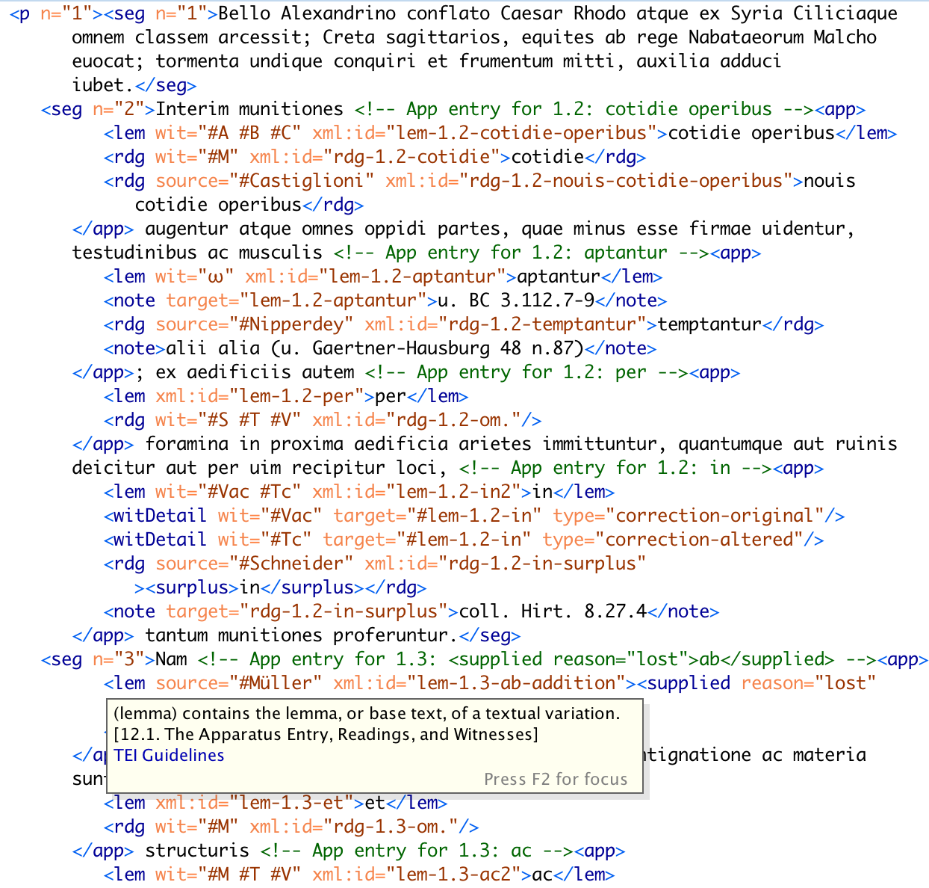
Notes:
This is what DLL is already doing
A traditional critical edition, which includes an edited version of an ancient text and possible alternate readings, is visually encoded data which is understandable by a person with relevant background. It is not machine readable.
An XML-encoded edition is a machine readable representation of the same textual data. It allows us to use computers to visualize, analyze, and better understand the text.
I have already developed a Python script to automate this process for simpler texts, like Caesar.
I realized as I started to get into Servius that the sequential, string-processing based way I was dealing with the other texts was not going to work for him

Slide 3
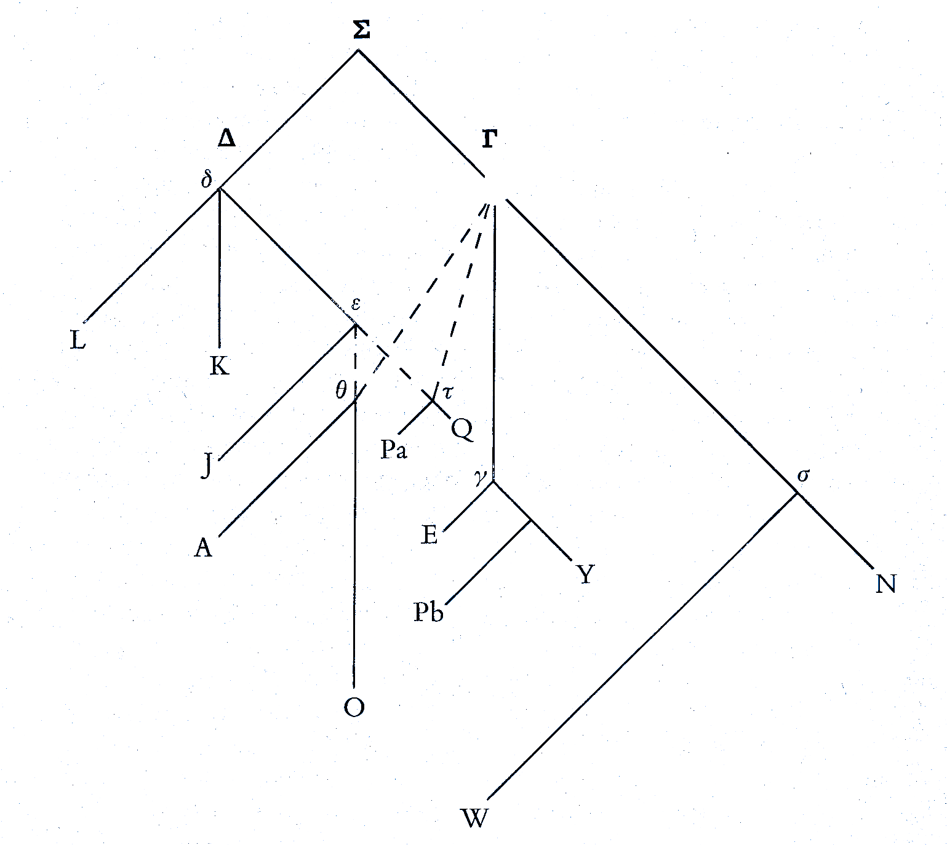
Notes:
However, Servius has a unique and complicated transmission history
Servius himself wrote in the late 4th century
His text was edited by an anonymous author we call the Compiler in about the 10th century
The compiler added substantial comments of his own and made changes to the original text
The two texts are passed down through separate manuscript traditions, both of which are significantly corrupted, i.e. there is lots of text missing
STEMMA: proposed diagram of the transmission history of the manuscript
What is shown above is JUST for Servius
There is a whole other tradition for Servius Auctus
Basically, this text is complicated

Slide 4
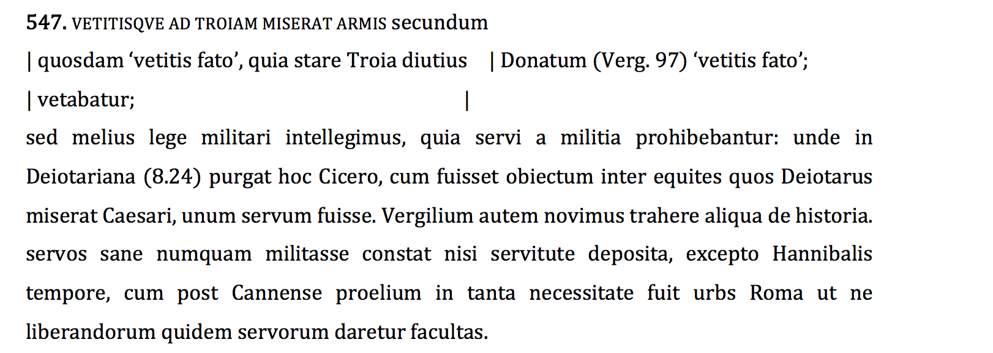
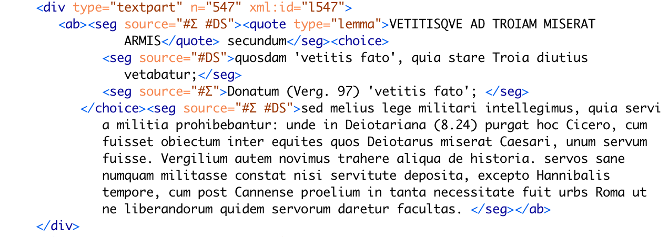
Notes:
Because of the strange transmission history, there are a lot of typographical conventions for representing Servius in print
These conventions have meaning to humans looking at the book, but they don’t have any meaning to a computer, or even outside of that specific edition of servius
Specifically, these refer to what I am calling the TYPE of a section of text
Servius
Auctus
Same
Parallel
The challenge was to get a computer to pick out these conventions, recognize their meaning, and encode them in a way that is meaningful to both humans and computers
Because different types of texts need to be processed differently, I needed a persistent way of associating a type with one (or potentially 2, for parallel sections) raw text strings and an XML string.
I briefly considered using a dict or list but ultimately decided to write a ServThing() class
Reasons: ease of use and encapsulation of type-dependent processing to simplify the main method
E.g. each ServThing generates an XML representation of itself
It can do this because it knows its own type
Then, the caller can use thing.xml for any ServThing and be guaranteed a correct XML representation of the object
Reduce processing time by greatly recuding the amount of if statements needed to process one ServThing
Especially important for iterative processing of ServThings, which is what my script does and is likely to be important in other applications

Slide 5
Demo time!
Notes:
I’ll switch over to python and show my demo here!

Slide 6
Servius: Future goals
Right now, the script processes the main text but does not encode either of the critical apparatuses (specialized footnotes listing variant readings)
Next goal: get the critical apparatus processing working
This will be very similar to what we have done for other types of text
Apply the concept object-oriented text representation to other texts
Starting with prose
Develop plain text to object representation and TEI-XML to object representation scripts

Slide 7
Applications of Object-oriented text representation
In representing Servius, I chose to use a class rather than an iterable (e.g. dict or list) primarily for ease of use.
Classes provide an intuitive, user-friendly way to interact with text
This is because we can leave type-checking, XML syntax validation, and other tedious, error-prone tasks to the class
Vision: a Python library that generates object representations of text from both plain text and TEI-XML inputs
Application: gives humanities scholars a simple interface for interacting programmatically with text
Abstracts away having to deal with XPath and XML syntax
Easy to use NLP and analysis tools, like the CLTK!

